Slide 1
Veterinary Science CDE
Parasite Identification
Resource Material

Slide 2
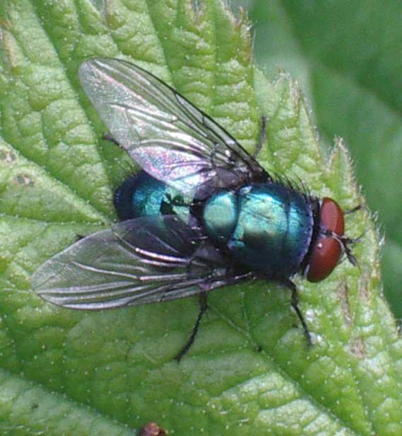
300. Blowfly

Slide 3
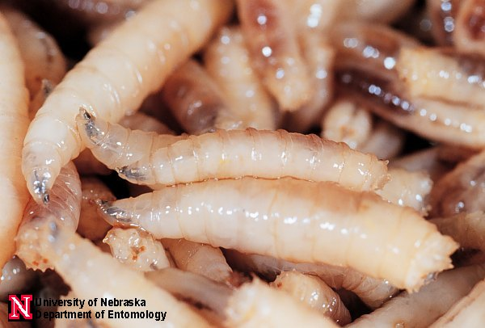
301. Blowfly Maggot

Slide 4
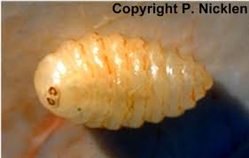
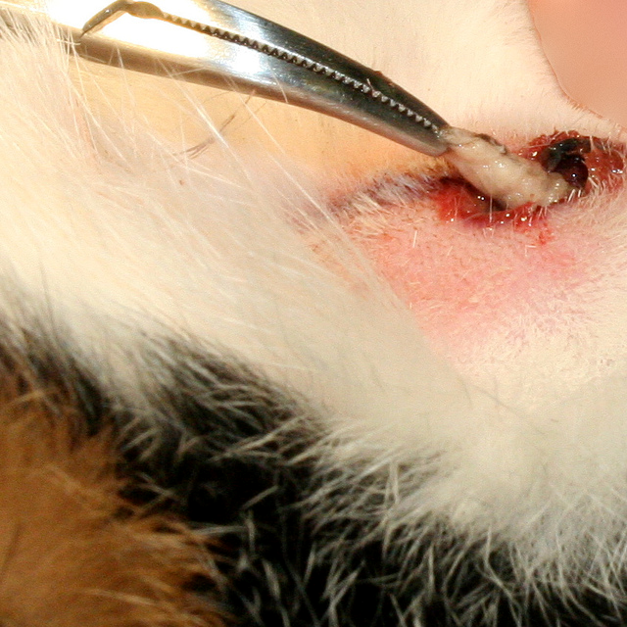
302. Cat Warble

Slide 5
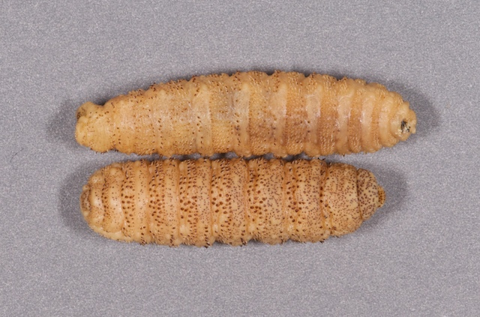
303. Cattle Grub

Slide 6
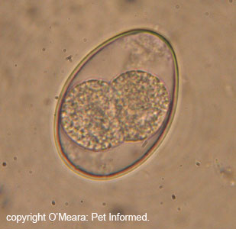
304. Coccidia

Slide 7
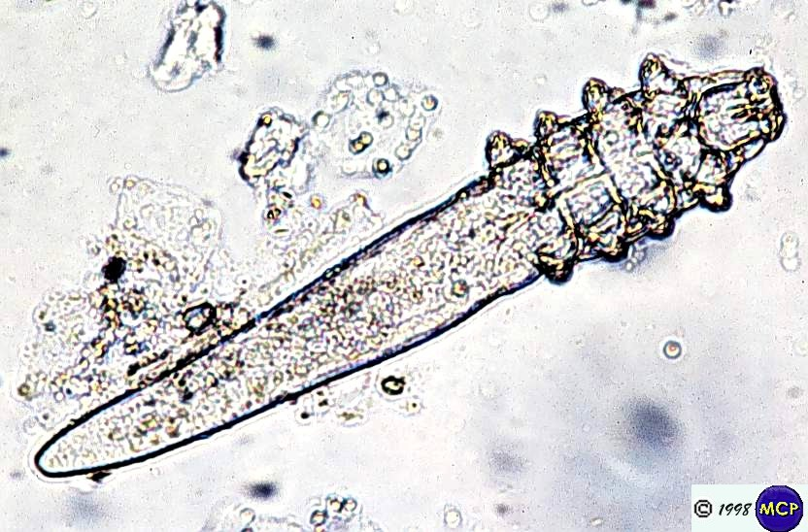
305. Demodectic Mite

Slide 8
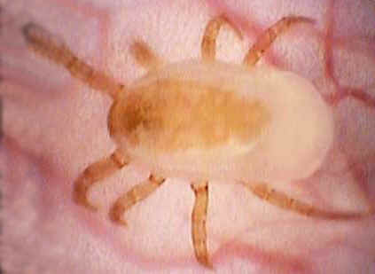
306. Ear Mite

Slide 9
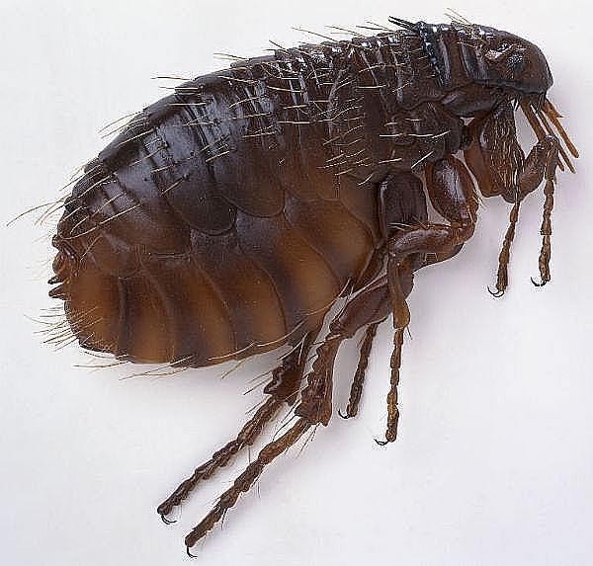
307. Fleas

Slide 10
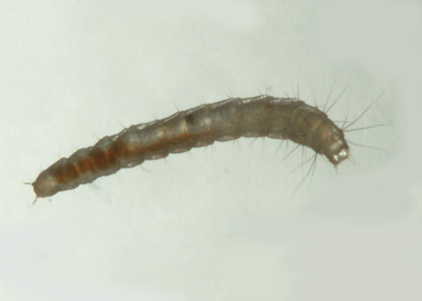
308. Flea Larva

Slide 11
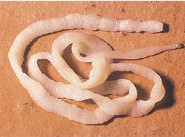
309. Flea Tapeworm

Slide 12
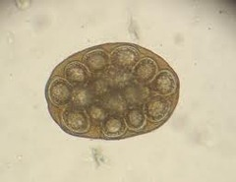
310. Flea Tapeworm Egg

Slide 13
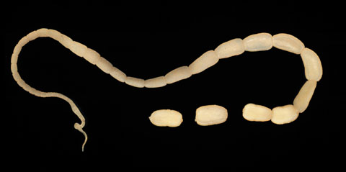
311. Flea Tapeworm Segment

Slide 14
312. Giardia

Slide 15
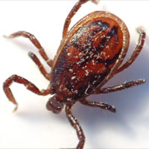
313. Hard Tick

Slide 16
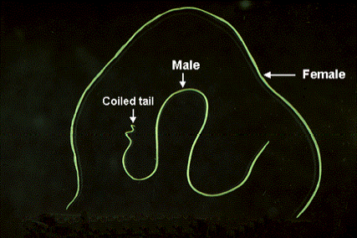
315. Heartworm Adult

Slide 17
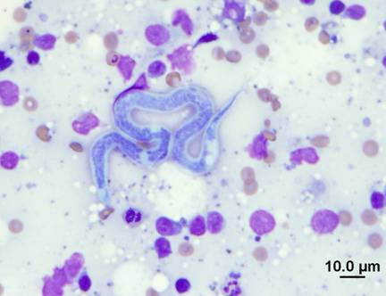
316. Heartworm Microfilaria

Slide 18
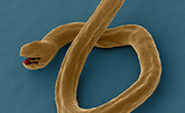
317. Hookworm Adult

Slide 19
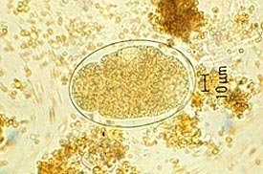
318. Hookworm Egg

Slide 20
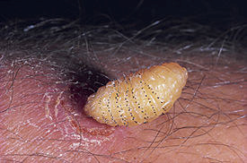
319. Horse Bots

Slide 21
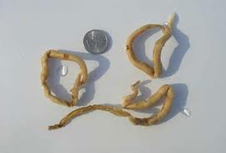
320. Horse Strongyles

Slide 22
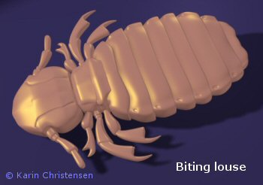
321. Lice- Biting

Slide 23
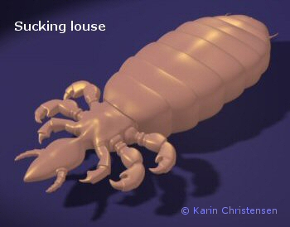
322. Lice- Sucking

Slide 24
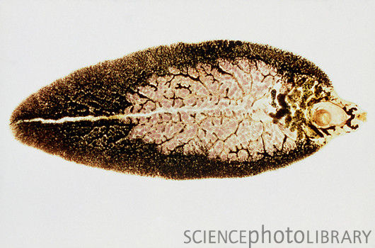
323. Liver Fluke

Slide 25
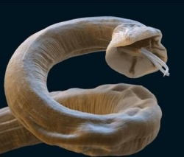
324. Lungworm

Slide 26
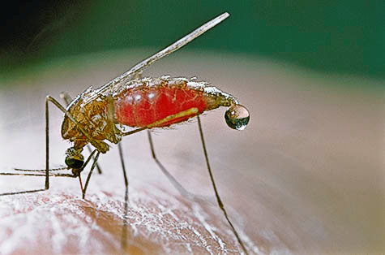
325. Mosquito Adult

Slide 27
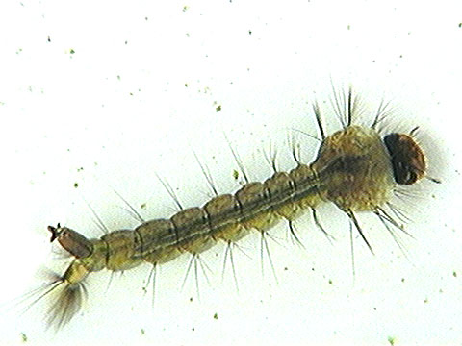
326. Mosquito Larva

Slide 28
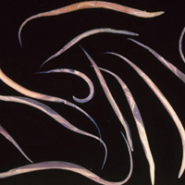
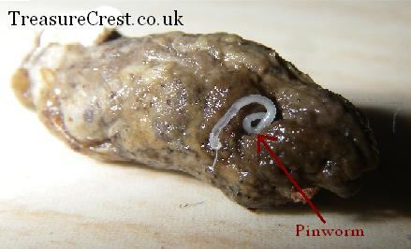
327. Pinworm

Slide 29
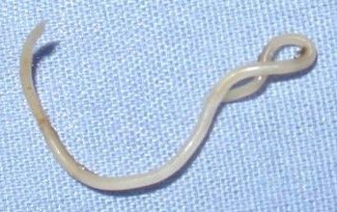
328. Roundworm Adult

Slide 30
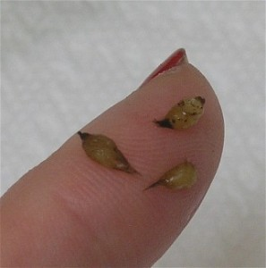
329. Roundworm Egg

Slide 31
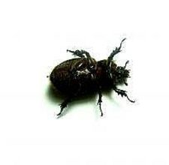
330. Sarcoptic Mite

Slide 32
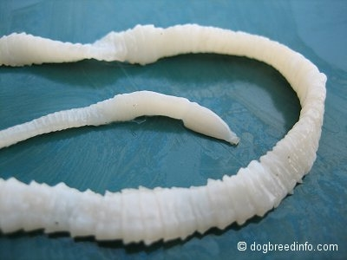
331. Taenia Tapeworm

Slide 33
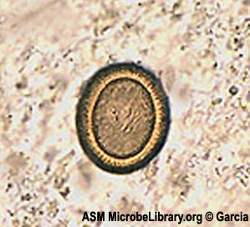
332. Taenia Tapeworm Egg

Slide 34
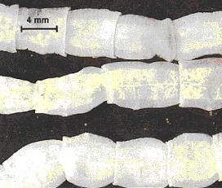
333. Taenia Tapeworm Segment

Slide 35
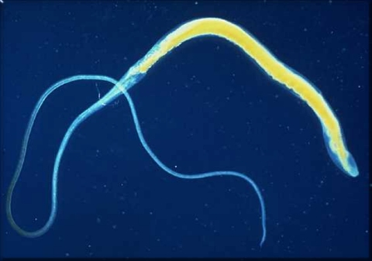
335. Whipworm

Slide 36
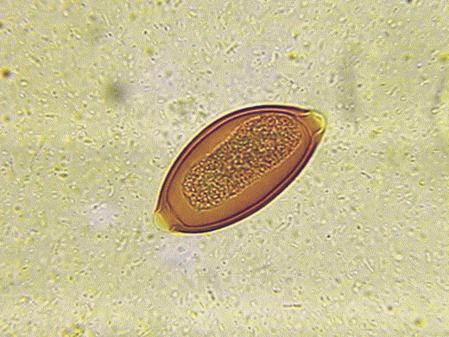
336. Whipworm Egg

